Slide 1
Imam al-Ghazali The Book of Knowledge from The Revival of Religious Sciences

Slide 2
Starter
How can you prove what you know?

Slide 3
Lesson objectives
All – Understand the importance of Logic and Law Most - To know the benefits of the rational faculty Some – To know the 5 reasons of Islamic Law

Slide 4
Finishing off last lesson why would the Muslim religion need a proof when we know our religion is true?
What the scholars meant when they called Imam al-Ghazali the “Proof of Islam” was simply that he had tested the practices in Islam and proved for himself that they were true. In other words, those practices had the effects that the Quran said they would have for people who practiced the commands of the Quran.

Slide 5
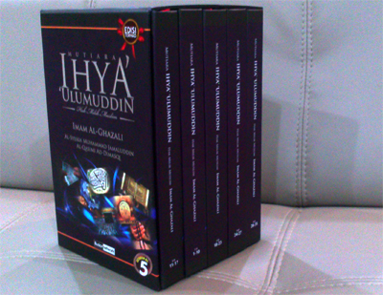
… and then he wrote it all down
The Revival of Islamic Sciences.
“Revival” is the act of bringing something back to life.
Notes:
Imam al-Ghazali “tested” the religion and proved that it does indeed do what it claims to do. He wrote a collection of 40 great books to help others to also “prove” Islam for themselves. He called that series of books The Revival of Islamic Sciences. “Revival” is the act of bringing something back to life. Imam al-Ghazali used this word because he thought that some Muslims had killed the spirit of Islam. What is the spirit of Islam? Spirit is what gives life to something, and what gives life to Islam is sincerity.

Slide 6
Fatimah presentation

Slide 7
Debate Club
When Imam al-Ghazali was very young, he had a great desire to learn. He studied almost all the time, and his teachers were amazed at how hard he worked to understand his subjects.
As he grew, he became very skilled at debating. The art of how to argue and persuade others is called debate.
He could debate anyone about any subject, and he was so learned and persuasive that he would always win. Soon he became a great scholar of many subjects, such as Arabic, Persian, logic, and grammar, and he excelled especially in the subject of law.

Slide 8
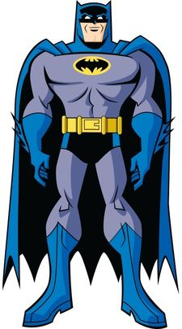
Lawyers AKA Superheroes and villains
Imam al-Ghazali was one of the greatest lawyers in Muslim history. A lawyer studies law to protect it from being abused or used wrongly. Some lawyers defend people accused of crimes while others prosecute or argue against the person accused of a crime. Imam al-Ghazali didn’t defend or prosecute people. He was the kind of lawyer who wrote about what law is and how it works. In other words, he was a philosopher of law.

Slide 9
Discussion- Group Activity
1- Can you imagine a society without laws? Do you know of any? Any countries?
What happens if we don’t have laws? What does it result in?
Do you know any other words for laws?
2- What if we don’t have Logic?
How would it affect us in our everyday scenarios?
Present your findings

Slide 10
So whats the point of Law, Logic and having the love of learning
Lets see…

Slide 11
Did you know…
Did you know that in Arabic, one is not considered a number on its own but only as part of all numbers? For example, the number two is made of two ones, the number three comprises three ones, and so on. All numbers begin with one because all things came from one source. That source is The One (al-Wahid), which is a name of God.

Slide 12
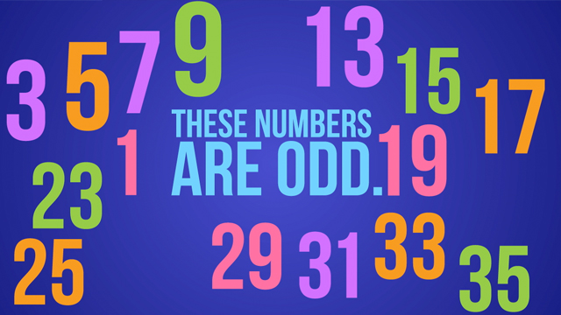
Did you know….
Did you know that all numbers are either even or odd? Any number you can think of is either even or odd. For example, the number 24 is an even number. Why is it even? It is even because you can split it perfectly in half. Half of 24 is 12, which is also an even number. You can split 12 in half, which is six. But an odd number can never be split in half without using a fraction.

Slide 13
Philoso-what?!
The word philosophy means “love of wisdom” and comes from two Greek words, philo (love) and sophos (wisdom). So a true philosopher is someone who loves wisdom. Do you know what wisdom is? It is using our knowledge in the best way possible. For example, sometimes, the best thing to do is be silent and other times, the best thing to do is speak up. Wisdom tells us when we should be silent and when we should speak up.
Do you want to be a philosopher?
Notes:
Good laws are wise laws. In other words, they contain wisdom. So even knowing when to apply a law, or not, is part of law. For example, stealing is wrong. But if a person is starving, and no one will give him any food, then God will not punish such a person for taking what he needs to survive. But it is only a wise person who can determine when stealing is punishable or not punishable: that is, only a wise person can decide that someone who steals deserves punishment or that he should not be punished because he was under duress or great difficulty.

Slide 14
Imam al Juwayni and his key advice
5 reasons of Islamic Law
Preserve Religion
Protect wealth and property
Protect family
Preserve Life
Protect your mind
Imam al-Ghazali had a great teacher named Imam al-Juwayni.
Notes:
Later on, another great scholar realized one more universal principle was missing and added a sixth one, which is to protect your dignity. Do you know what dignity is? It is what makes you a special creature and why you should always behave in ways that honor and protect your special place with God. God did not make you like a snake that slithers and slides on its belly, or like a dog that walks on all fours. Instead, God made you a creature that walks upright. Upright means straight, not bent or crooked. It also has a second meaning, which is to behave in a good way, with virtue and excellence. So dignity is The Book of Knowledge For Children 18 something every human being has, but some lose it or let others take it from them. Sometimes, bad people purposely degrade or humiliate others: that means they take their dignity from them. For instance, some people will treat others badly because their skin color is different. In Islam, that is wrong because it goes against this sixth reason behind Islamic law, which is to protect dignity. The Quran says that it is a sign of God when we see people with complexions of different colors. So when you see a red, black, yellow, or white person, you should be amazed that God made so many different colors of skin!

Slide 15
Task
Answer the following questions
What would happen if “Preserve life” wasn’t in the aims of sacred law.
Where do you think extremists in religion go wrong in understanding the aims of the sacred law.
If you could add to the 5 reasons of Islamic Law, what would you add?

Slide 16
Homework
Draw a poster showing the 5 reasons of Islamic Law
You need to show its benefits and how it can help.

